Slide 1
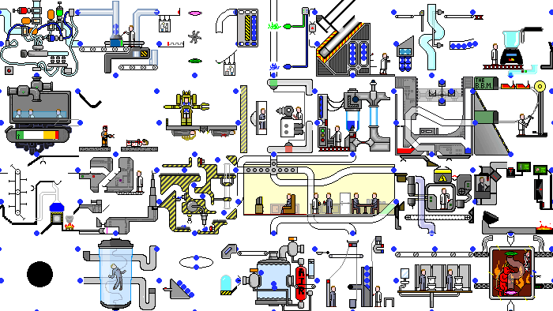
GPars:
Unsung Hero of Concurrency in Practice
http://playstationna.i.lithium.com/t5/image/serverpage/image-id/432281iDADEAFC04868CE5C?v=1.0

Slide 2
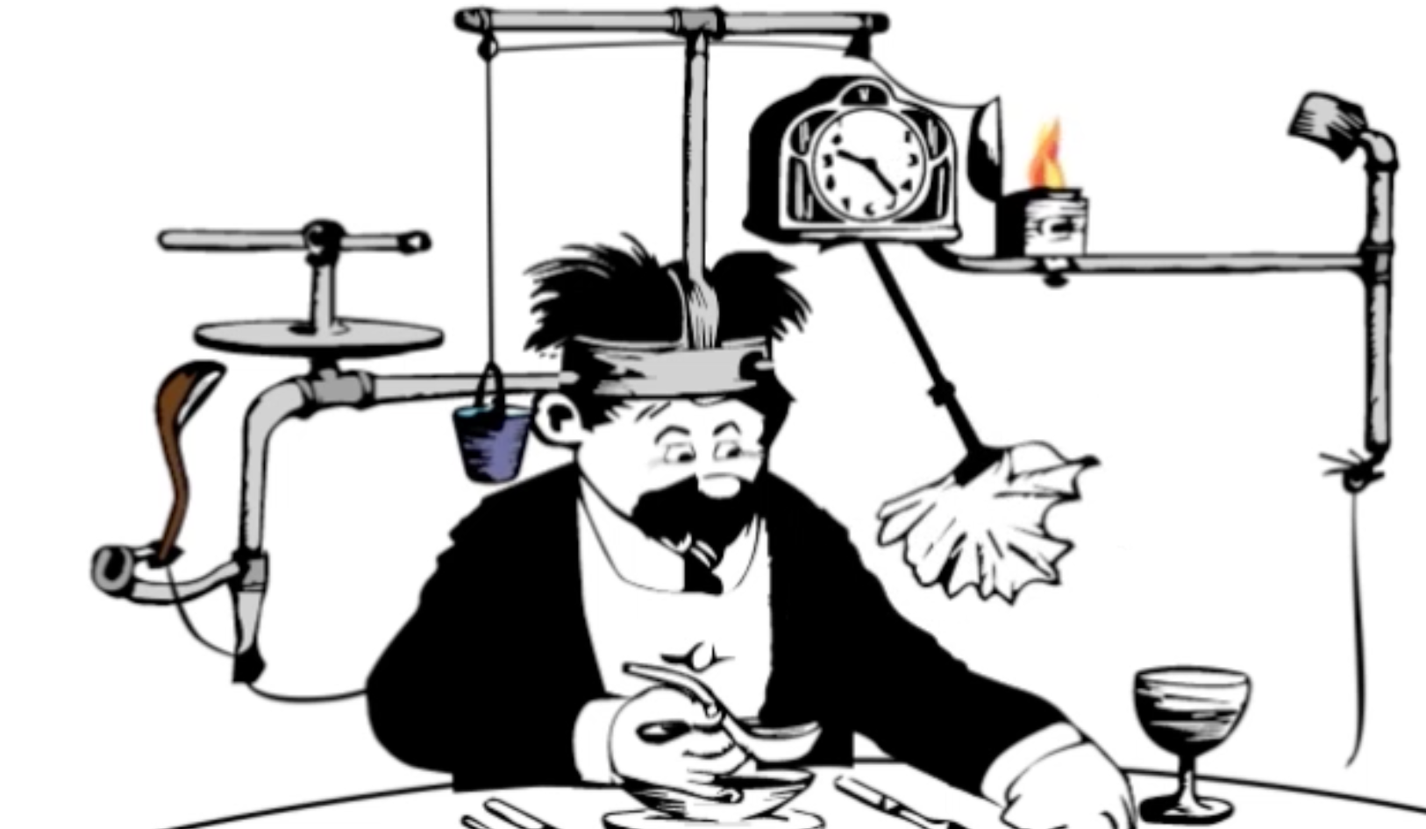
Yaroslav Yermilov yermilov17@gmail.com https://yermilov.github.io/ https://twitter.com/yermilov17 https://www.facebook.com/yaroslav.yermilov https://ua.linkedin.com/pub/yaroslav-yermilov/58/682/506
worked for EPAM Systems since 2011 distributed systems, Big Data and automated testing
https://motherboard.vice.com/en_us/article/inside-rube-goldberg-machine-youtube-video-artist-joseph-herschers-bedroom-workshop

Slide 3
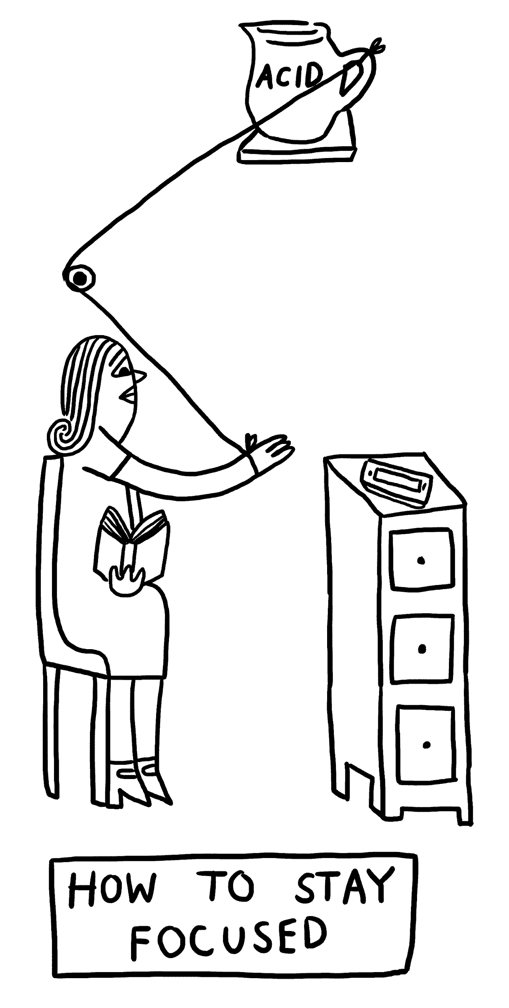
Focus for this talk
When it comes to concurrency and parallelism,
first things to appear in someone’s mind may be “Java Concurrency in Practice” by Brian Göetz, threads, java.util.concurrent, Fork-Join, parallel streams, reactive, Akka or MapReduce.
When it comes to Groovy, first things to appear in someone’s mind may be Gradle, Grails, Spock, DSLs or scripting.
http://www.theverge.com/2015/4/22/8381963/rube-goldberg-machine-contest-history-ideas

Slide 4
Focus for this talk
Great injustice is that you rarely meet GPars in both these lists.
Framework that provides high-level APIs and DSLs for writing concurrent and parallel code both in Java and Groovy
and support for concepts of map/reduce, fork/join, asynchronous code, actors, agents, dataflows (not all mentioned) deserves a little more attention, isn’t it?
http://www.theverge.com/2015/4/22/8381963/rube-goldberg-machine-contest-history-ideas

Slide 5
Focus for this talk
In this talk we will try to fix it. One by one, we will explore various use cases of GPars with all its pragmatism and conciseness.
Not forgetting neither plain Java nor Groovy adepts, we will use Groovy to empower our solutions and ensure that everything works from Java the same way.
http://www.theverge.com/2015/4/22/8381963/rube-goldberg-machine-contest-history-ideas

Slide 6
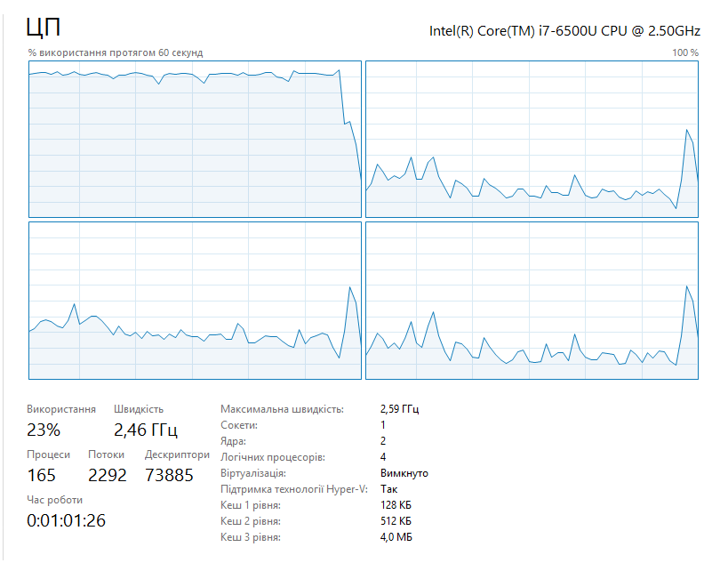
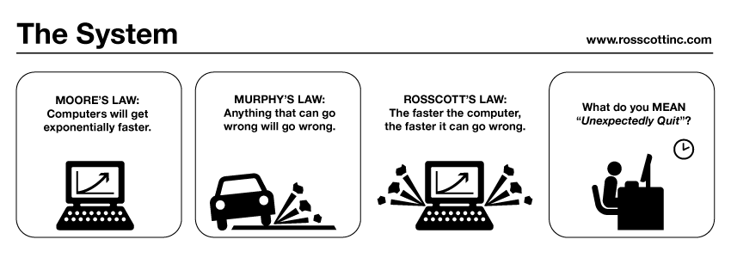
MOORE’S LAW:
Computers will get exponentially faster.
your code may not
http://www.systemcomic.com/2009/04/27/the-system-197

Slide 7
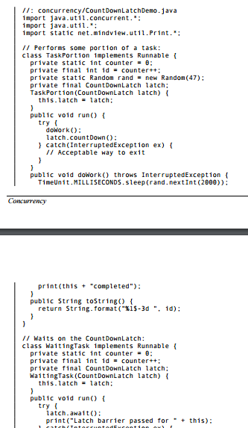
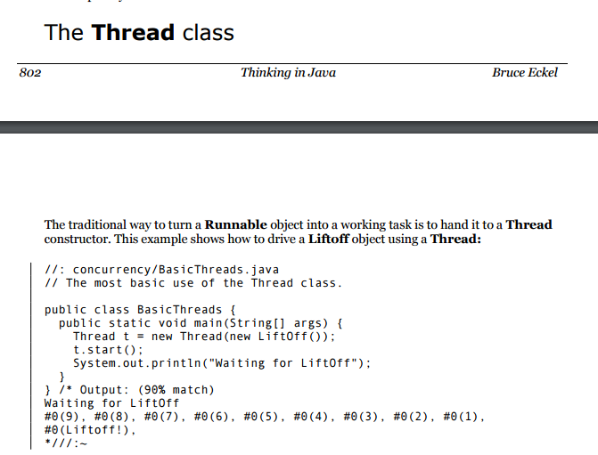
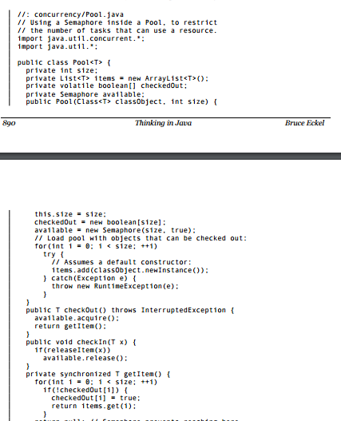
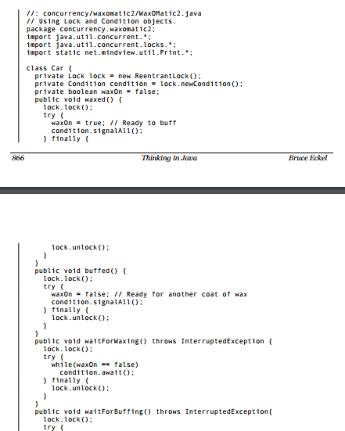
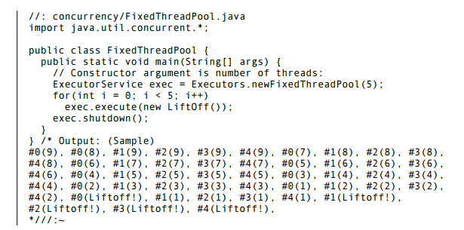
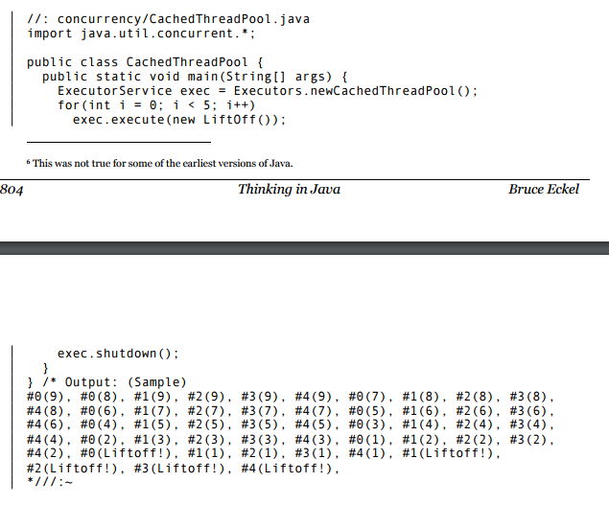
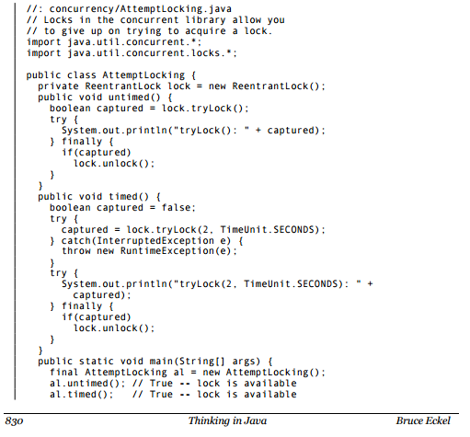
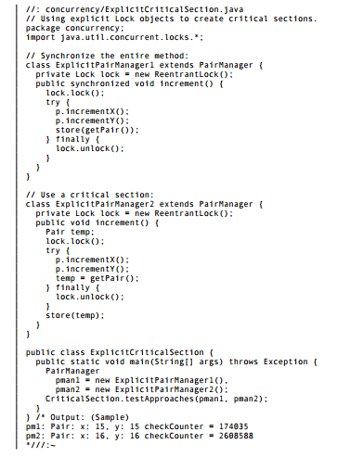
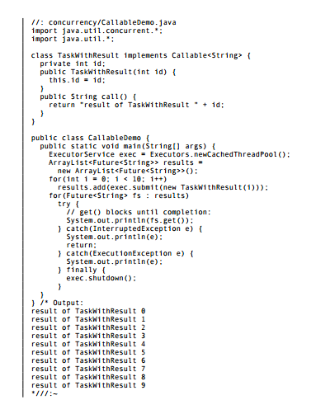
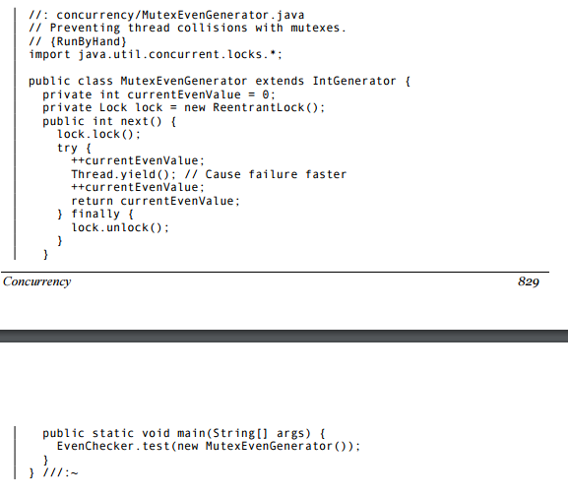
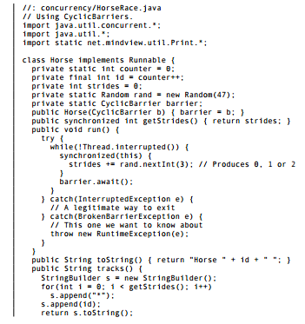
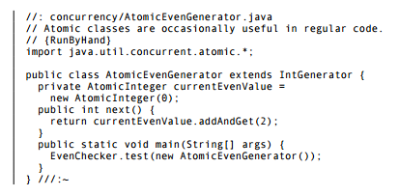
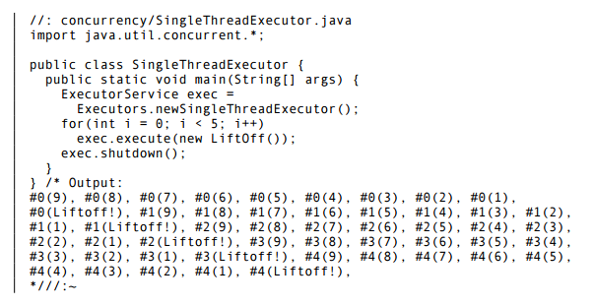

Slide 8
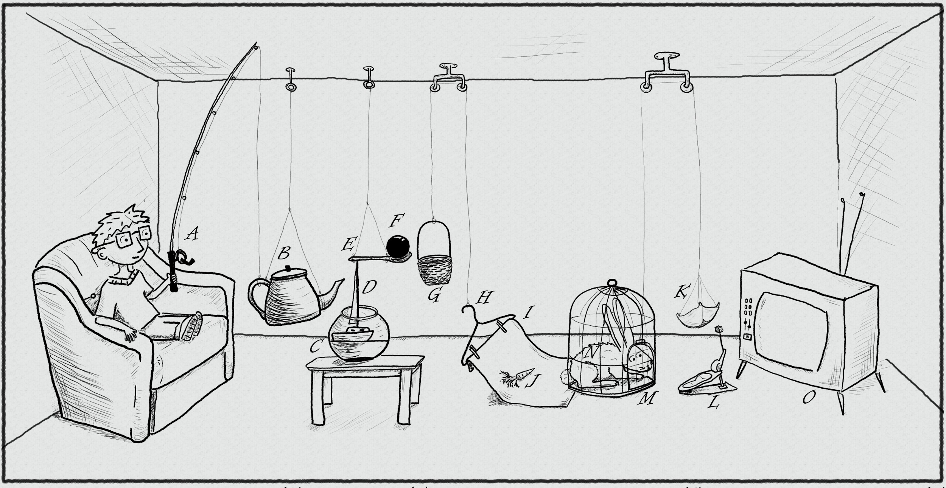
The traditional thread-based concurrency model built into Java doesn’t match well with the natural human sense for parallelism.
https://www.pinterest.com/pin/395190936024778319/

Slide 9
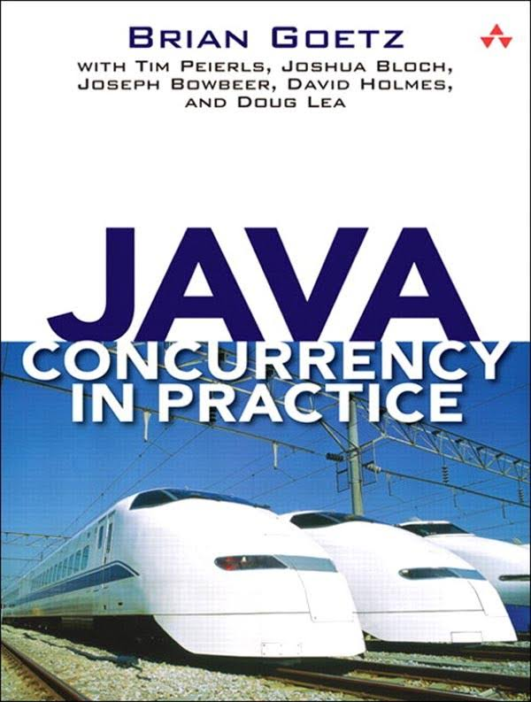
If multiple threads access the same mutable state variable without appropriate synchronization, your program is broken.

Slide 10
MURPHY’S LAW:
Anything that can go wrong will go wrong.
public class Holder {
private int n;
public Holder(int n) { this.n = n; }
public void assertSanity() {
if (n != n) {
throw new AssertionError("Even it can go wrong!");
}
}
}
public class Initializer {
public Holder holder;
public void init() { holder = new Holder(42); }
}
public class Holder {
private int n;
public Holder(int n) { this.n = n; }
public void assertSanity() {
if (n != n) {
throw new AssertionError("Even it can go wrong!");
}
}
}
http://www.systemcomic.com/2009/04/27/the-system-197

Slide 11
If multiple threads access the same mutable state variable without appropriate synchronization, your program is broken.
If multiple threads access the same mutable state variable without appropriate synchronization, your program is broken.
There are three ways to fix it:
Don’t share the state variable across threads

Slide 12
If multiple threads access the same mutable state variable without appropriate synchronization, your program is broken.
There are three ways to fix it:
Don’t share the state variable across threads
Make the state variable immutable

Slide 13
If multiple threads access the same mutable state variable without appropriate synchronization, your program is broken.
There are three ways to fix it:
Don’t share the state variable across threads
Make the state variable immutable
Use synchronization whenever accessing the state variable

Slide 14

.parallel()
Optional<Status> mostPopularTweet = tweets.stream()
.filter(tweet -> tweet.getText().toLowerCase().contains(topic.toLowerCase()))
.filter(tweet -> !tweet.isRetweet())
.max(comparingInt(tweet -> tweet.getFavoriteCount() + tweet.getRetweetCount()));

Slide 15
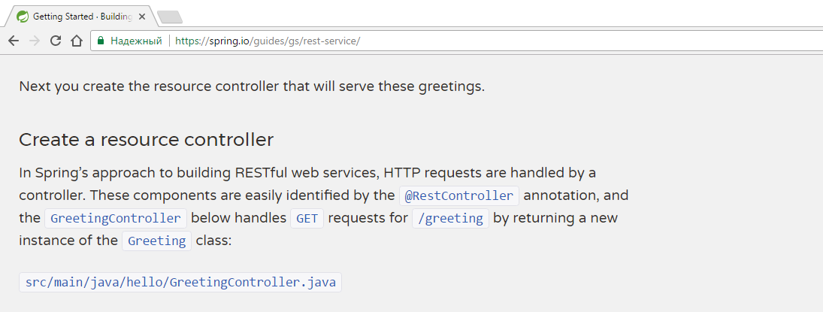
@RestController
public class GreetingController {
private static final String template = "Hello, %s!";
private final AtomicLong counter = new AtomicLong();
@RequestMapping("/greeting")
public Greeting greeting(@RequestParam(value="name", defaultValue="World") String name) {
return new Greeting(counter.incrementAndGet(), String.format(template, name));
}
}

Slide 16
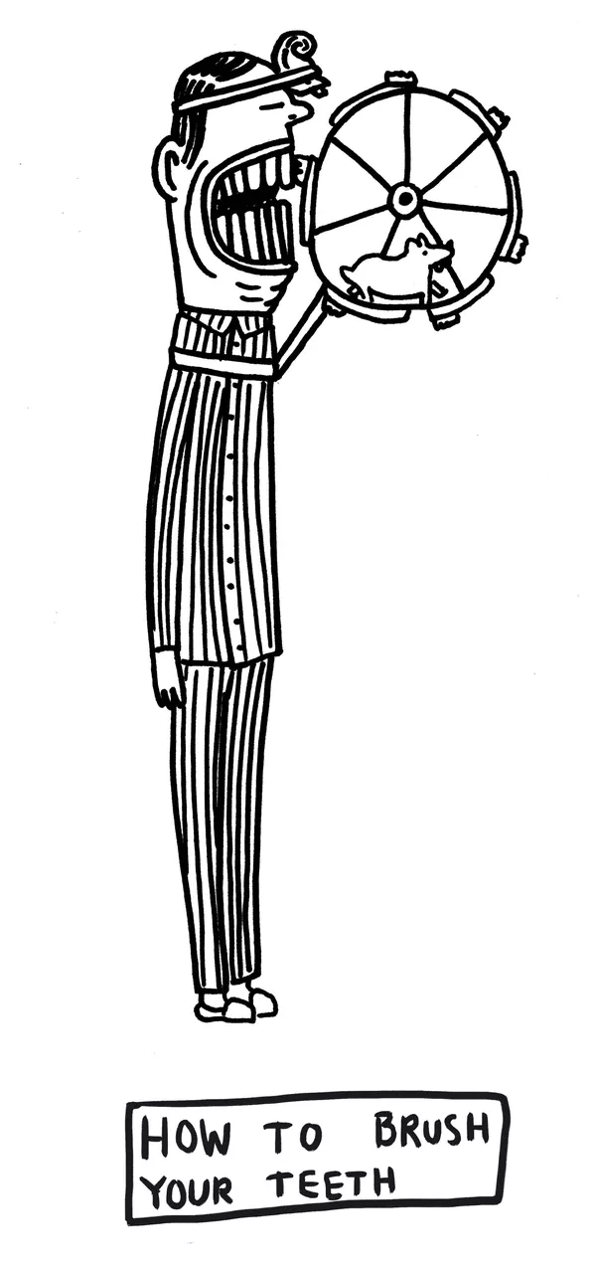
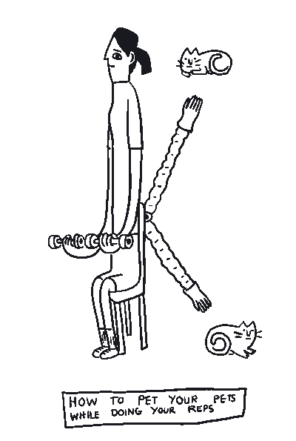
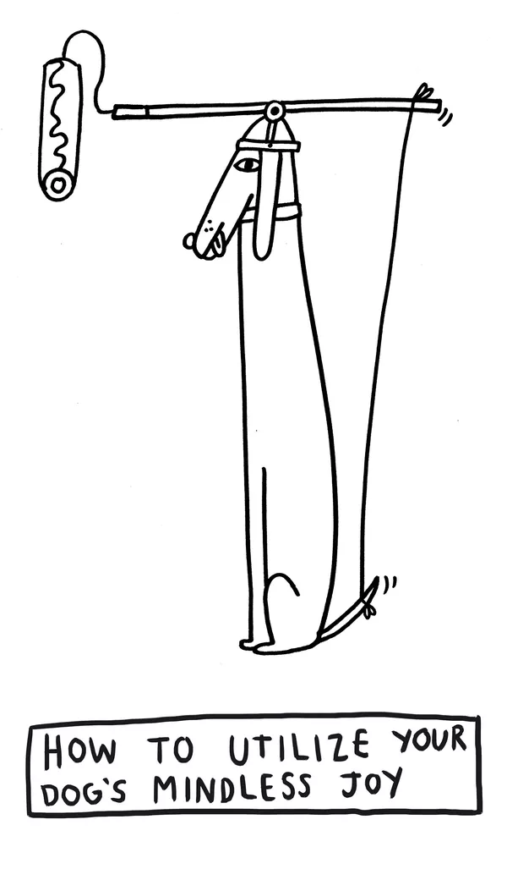
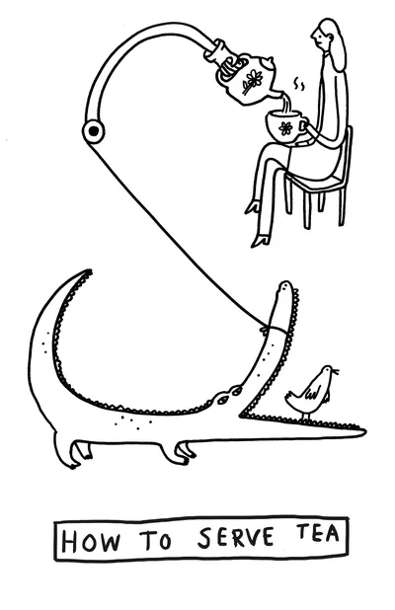
GPars
data parallelism
map/reduce
fork/join
asynchronous execution
actors
agents
dataflows
remote execution
Communicating Sequential Processes
Software Transactional Memory
http://www.theverge.com/2015/4/22/8381963/rube-goldberg-machine-contest-history-ideas

Slide 17
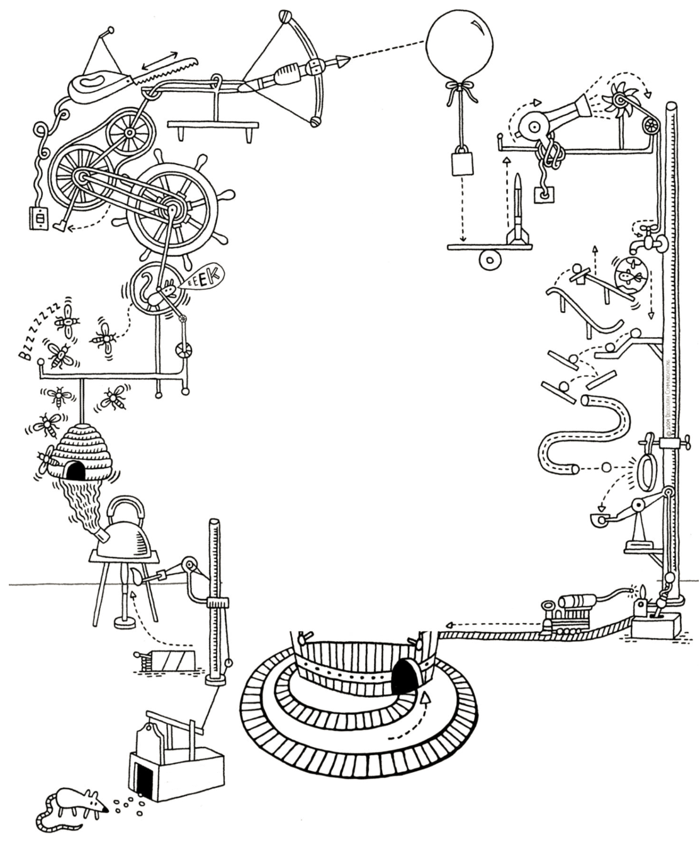
JAVA
OR
GROOVY?
http://forevercuriousmuseum.org/events/rube-goldberg-machine-summer-camp-july-28-29-30-2015/

Slide 18
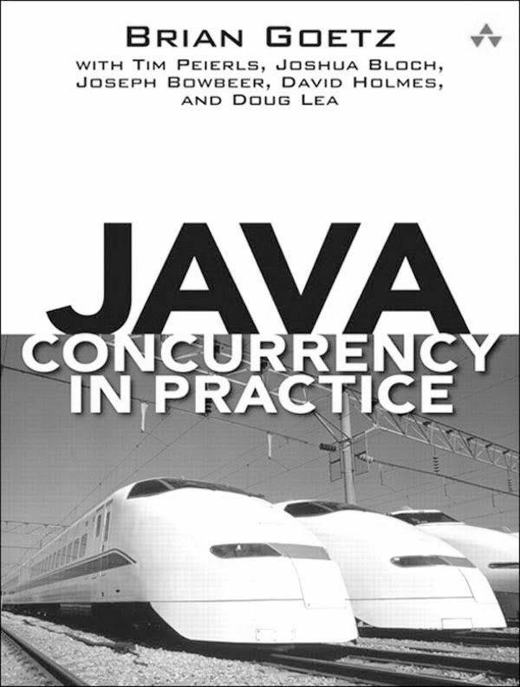
If multiple threads access the same mutable state variable without appropriate synchronization, your program is broken.
There are three ways to fix it:
Don’t share the state variable across threads
Make the state variable immutable
Use synchronization whenever accessing the state variable

Slide 19
public final class ImmutableJavaPerson {
private final String name;
private final Collection<String> tweets;
public ImmutableJavaPerson(String name, Collection<String> tweets) {
this.name = name;
this.tweets = new ArrayList<>(tweets);
}
public String getName() {
return name;
}
public Collection<String> getTweets() {
return unmodifiableCollection(tweets);
}
@Override
public boolean equals(Object o) {
if (this == o) return true;
if (o == null || getClass() != o.getClass()) return false;
ImmutableJavaPerson that = (ImmutableJavaPerson) o;
if (name != null ? !name.equals(that.name) : that.name != null) return false;
return tweets != null ? tweets.equals(that.tweets) : that.tweets == null;
}
@Override
public int hashCode() {
int result = name != null ? name.hashCode() : 0;
result = 31 * result + (tweets != null ? tweets.hashCode() : 0);
return result;
}
}

Slide 20
@Override
public boolean equals(Object o) {
if (this == o) return true;
if (o == null || getClass() != o.getClass()) return false;
ImmutableJavaPerson that = (ImmutableJavaPerson) o;
if (name != null ? !name.equals(that.name) : that.name != null) return false;
return tweets != null ? tweets.equals(that.tweets) : that.tweets == null;
}
@Override
public int hashCode() {
int result = name != null ? name.hashCode() : 0;
result = 31 * result + (tweets != null ? tweets.hashCode() : 0);
return result;
}
}

Slide 21

@Immutable class ImmutableGroovyPerson {
String name
Collection<String> tweets
}

Slide 22

@Immutable class ImmutableGroovyPerson {
String name
Collection<String> tweets
}

Slide 23
class SynchronizedCounter {
int atomicCounter
int counter
@Synchronized
int incrementAndGet() {
atomicCounter = atomicCounter + 1
return atomicCounter
}
@WithReadLock
int value() {
counter
}
@WithWriteLock
void increment() {
counter = counter + 1
}
}

Slide 24
def thread1 = Thread.start {
println "Hello from ${Thread.currentThread().name}"
}
def thread2 = Thread.startDaemon {
println "Hello from ${Thread.currentThread().name}"
}
[ thread1, thread2 ]*.join()

Slide 25
def process = (['git', 'status']).execute([], new File('.'))
def processOutput = new StringWriter()
process.consumeProcessOutput processOutput, processOutput
process.waitFor()
println processOutput.toString().trim()

Slide 26
def config = new CompilerConfiguration()
config.addCompilationCustomizers(new ASTTransformationCustomizer(ThreadInterrupt))
def binding = new Binding(i:0)
def shell = new GroovyShell(binding,config)
def t = Thread.start {
shell.evaluate(userCode)
}
t.join(1000)
if (t.alive) {
t.interrupt()
}
@TimedInterrupt(value=1, unit=TimeUnit.SECONDS)
class FibCalculator {
def fib(int n) {
n < 2 ? n : fib(n - 1) + fib(n - 2)
}
}
@ConditionalInterrupt({ Quotas.disallow('user') })
class UserService {
void longRunningRequest() { ... }
}

Slide 27
"Hello from ${Thread.currentThread().name}"
'''Multi-line
strings'''
def numbers = [ 1, 2, 3 ]
def colors = [ red: '#ff0000', green: '#00ff00', blue: '#0000ff' ]
carNames = car*.name
Closure sum = { a, b -> a + b }
Closure increment = sum.curry(1)
name = user?.name
displayName = user.name ?: 'unknown'
assert new String('text') == new String('text')
assert (2 <=> 5) == -1
Object str1 = 'text'
def str2 = str1
assert str1.length() == str2.length()
def sneakyThrow() { throw new IOException("i don't care") }
@IgnoreIf({ os.linux || jdk.version == 8 })

Slide 28
def rows = Sql.newInstance(url, user, password, driver).rows "SELECT * FROM table"
(0..<5).collect { it % 2 == 0 }
println list.find { it > 7 }
if (4 in nums) println 'yes'
println persons.max({ person -> person.age })
5.times { println 'hello!' }
println list[0..2]
def json = new JsonSlurper().parseText(jsonText)
json.clients[3].location.country.code
def xml = new XmlSlurper().parseText(xmlText)
xml.clients[3].location.country.@code
xmlBuilder.root(attribute: 28) {
elem1('hello')
elem2('xml')
}
new File('poem.txt').eachLine { line ->
println line
}
def increment(int number, int delta = 0) { ... }
def connectJdbc(Map params) { ... }
connectJdbc(url: 'jdbc://', driver: 'generic', username: 'admin', password: 'admin')

Slide 29
@Grab(group='org.springframework', module='spring-orm', version='4.3.8.RELEASE')
import org.springframework.jdbc.core.JdbcTemplate
@TypeChecked
@CompileStatic
@Canonical
@InheritConstructors
@Lazy
@Sortable
@Builder
@Delegate
@Memoized
@Singleton
@Log
class MetaProgramming {
def methodMissing(String methodName, def methodArgs) { ... }
}
Number.metaClass.doubleIt = { -> delegate * 2 }
ReturnStatement returnStatement = macro { return "42" }
class MyNumber {
MyNumber plus(MyNumber other) { ... }
}
trait DatabaseTest { ... }
please show the square_root of 100
new GroovyShell(variables).evaluate 'println persons.sort { person -> person.name }'

Slide 30
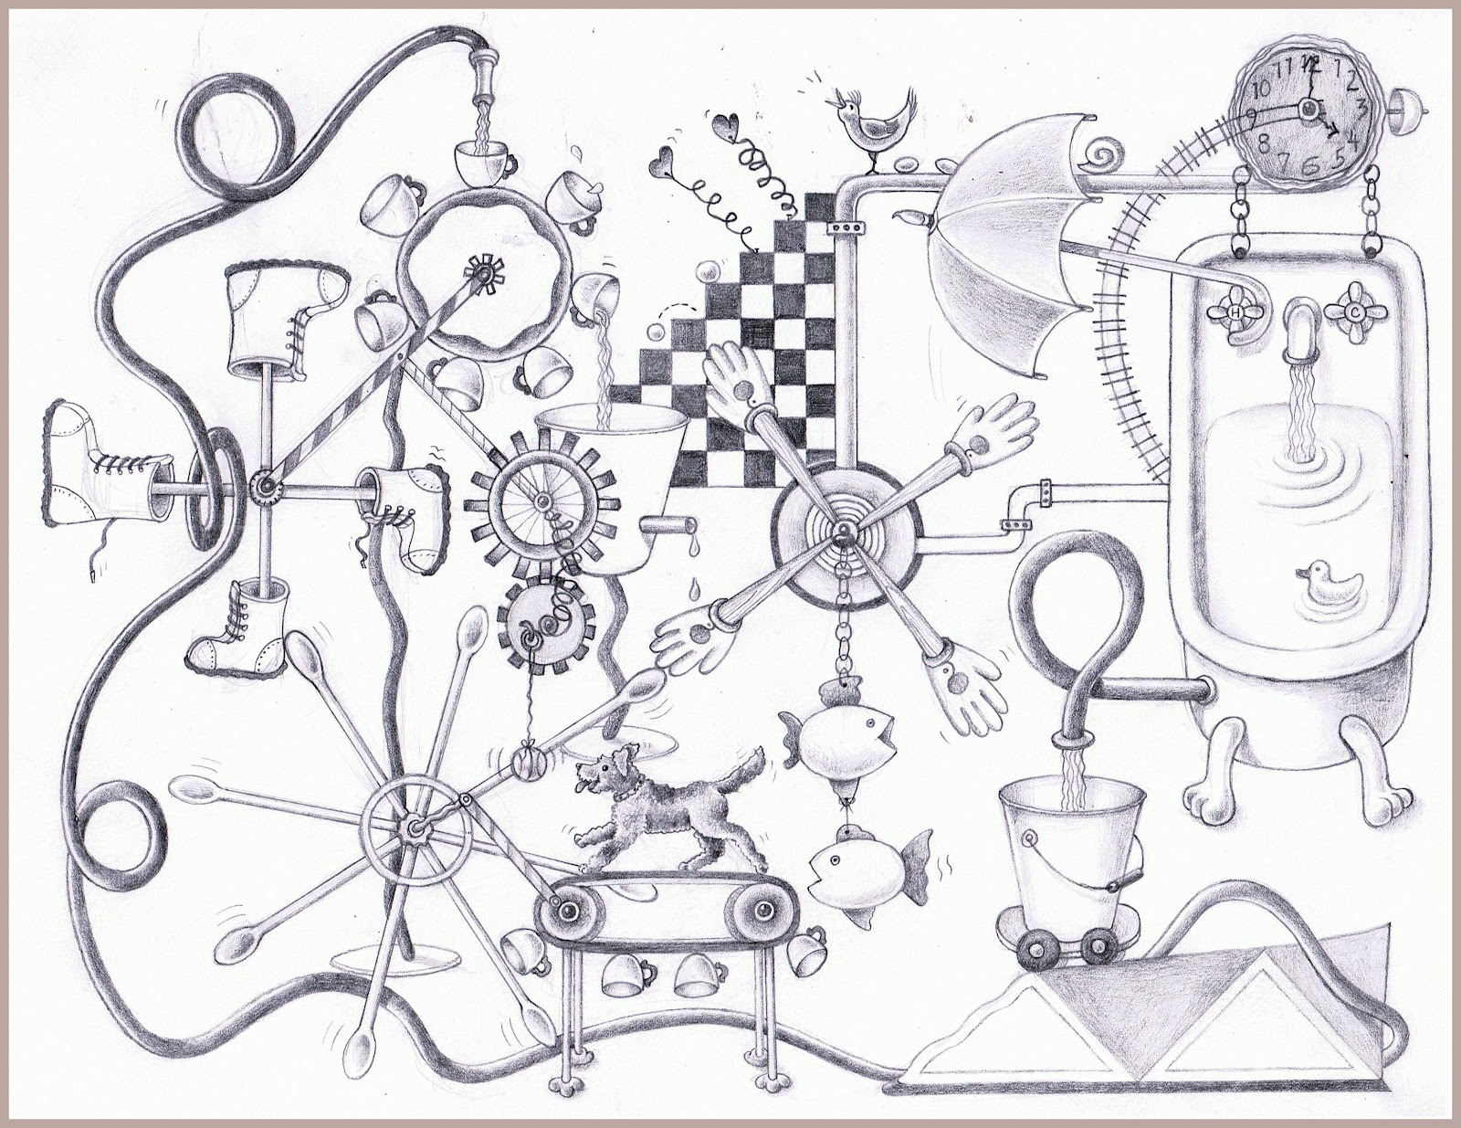

goo.gl/Xu6tSH
https://www.pinterest.com/pin/527554543837493577/

Slide 31
min

Slide 32
min

Slide 33
min

Slide 34
min

Slide 35
min

Slide 36
min
min
min
min

Slide 37
shapes.stream()

Slide 38
Optional<Shape> minBlueCircle = shapes.stream()
.filter(shape -> shape.getType() == CIRCLE)

Slide 39
Optional<Shape> minBlueCircle = shapes.stream()
.filter(shape -> shape.getType() == CIRCLE)
.filter(shape -> shape.getColor() == BLUE)

Slide 40
Optional<Shape> minBlueCircle = shapes.stream()
.filter(shape -> shape.getType() == CIRCLE)
.filter(shape -> shape.getColor() == BLUE)
.min(comparingInt(shape -> shape.getSize()));

Slide 41
min
Optional<Shape> minBlueCircle = shapes.stream()
.parallel()
.filter(shape -> shape.getType() == CIRCLE)
.filter(shape -> shape.getColor() == BLUE)
.min(comparingInt(shape -> shape.getSize()));
.filter(shape -> shape.getType() == CIRCLE)
.filter(shape -> shape.getColor() == BLUE)
.min(comparingInt(shape -> shape.getSize()));

Slide 42
shapes

Slide 43
Shape minBlueCircle = shapes
.findAll({ shape -> shape.type == CIRCLE })

Slide 44
Shape minBlueCircle = shapes
.findAll({ shape -> shape.type == CIRCLE })
.findAll({ shape -> shape.color == BLUE })

Slide 45
Shape minBlueCircle = shapes
.findAll({ shape -> shape.type == CIRCLE })
.findAll({ shape -> shape.color == BLUE })
.min({ shape -> shape.size })

Slide 46
ParallelEnhancer.enhanceInstance shapes
Shape minBlueCircle = shapes
.findAllParallel({ shape -> shape.type == CIRCLE })
.findAllParallel({ shape -> shape.color == BLUE })
.minParallel({ shape -> shape.size })

Slide 47
min
ParallelEnhancer.enhanceInstance shapes
shapes.makeConcurrent()
Shape minBlueCircle = shapes
.findAll({ shape -> shape.type == CIRCLE })
.findAll({ shape -> shape.color == BLUE })
.min({ shape -> shape.size })
.findAll({ shape ->
shape.type == CIRCLE
})

Slide 48
min
ParallelEnhancer.enhanceInstance shapes
shapes.makeConcurrent()
Shape minBlueCircle = shapes
.findAll({ shape -> shape.type == CIRCLE })
.findAll({ shape -> shape.color == BLUE })
.min({ shape -> shape.size })
.findAll({ shape ->
shape.color == BLUE
})

Slide 49
min
ParallelEnhancer.enhanceInstance shapes
shapes.makeConcurrent()
Shape minBlueCircle = shapes
.findAll({ shape -> shape.type == CIRCLE })
.findAll({ shape -> shape.color == BLUE })
.min({ shape -> shape.size })
.min({ shape -> shape.size
})

Slide 50
Shape minBlueCircle = shapes
.findAll({ shape -> shape.type == CIRCLE })
.findAll({ shape -> shape.color == BLUE })
.min({ shape -> shape.size })

Slide 51
min
withPool {
Shape minBlueCircle = shapes.parallel
.filter({ shape -> shape.type == CIRCLE })
.filter({ shape -> shape.color == BLUE })
.min({ shape -> shape.size })
}
.filter({ shape -> shape.type == CIRCLE })
.filter({ shape -> shape.color == BLUE })
.min({ shape -> shape.size })

Slide 52
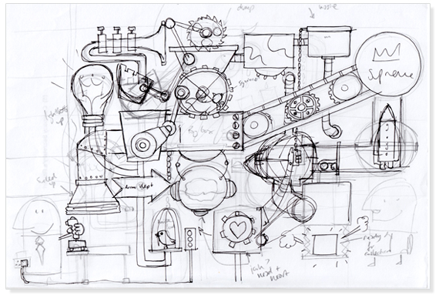
withPool
https://discoveryartjoy.wordpress.com/page/2/

Slide 53
withPool {
}

Slide 54
GParsPool.withPool {
}

Slide 55
GParsPool.withPool { ForkJoinPool pool ->
}

Slide 56
GParsExecutorsPool.withPool { ExecutorService executor ->
}

Slide 57
withPool {
}
ParallelEnhancer.enhanceInstance shapes // not needed inside withPool
Shape minBlueCircle = shapes
.findAllParallel({ shape -> shape.type == CIRCLE })
.findAllParallel({ shape -> shape.color == BLUE })
.minParallel({ shape -> shape.size })
shapes.makeConcurrent()
Shape minBlueCircle = shapes
.findAll({ shape -> shape.type == CIRCLE })
.findAll({ shape -> shape.color == BLUE })
.min({ shape -> shape.size })
Shape minBlueCircle = shapes.parallel
.filter({ shape -> shape.type == CIRCLE })
.filter({ shape -> shape.color == BLUE })
.min({ shape -> shape.size })

Slide 58
withPool {
}

Slide 59
withPool {
List latestTweets = twitter.fetchLatestTweets()
println 'Done:'
println latestTweets
}

Slide 60
withPool {
Future latestTweets = executeAsync({ twitter.fetchLatestTweets() })
println 'Loading...'
println latestTweets.get()
}

Slide 61
withPool {
Future latestTweets = twitter.&fetchLatestTweets.callAsync()
println 'Loading...'
println latestTweets.get()
}

Slide 62
withPool {
Closure fetchLatestTweetsAsync = twitter.&fetchLatestTweets.async()
Future latestTweets = fetchLatestTweetsAsync()
println 'Loading...'
println latestTweets.get()
}

Slide 63
withPool {
Closure fetchLatestTweetsAsync = twitter.&fetchLatestTweets.async()
Future latestTweets = fetchLatestTweetsAsync()
Closure extractKeywordsAsync = keywords.&extractKeywords.async()
println 'Loading tweets...'
Future keywords = extractKeywordsAsync(latestTweets.get())
println 'Extracting keywords...'
println keywords.get()
}

Slide 64
withPool {
Closure fetchLatestTweetsAsync = twitter.&fetchLatestTweets.async()
Future latestTweets = fetchLatestTweetsAsync()
Closure extractKeywordsAsync = keywords.&extractKeywords.async()
println 'Loading tweets...'
Future keywords = extractKeywordsAsync(latestTweets.get())
println 'Extracting keywords...'
println keywords.get()
}
List<Keywords> extractKeywords(List<Tweet> tweets)
Future extractKeywordsAsync(List<Tweet> tweets)

Slide 65
withPool {
Closure fetchLatestTweetsAsync = twitter.&fetchLatestTweets.asyncFun()
Promise latestTweets = fetchLatestTweetsAsync()
Closure extractKeywordsAsync = keywords.&extractKeywords.asyncFun()
Promise keywords = extractKeywordsAsync(latestTweets)
println 'Loading tweets and extracting keywords...'
println keywords.get()
}

Slide 66
withPool {
Closure fetchLatestTweetsAsync = twitter.&fetchLatestTweets.asyncFun()
Promise latestTweets = fetchLatestTweetsAsync()
Closure extractKeywordsAsync = keywords.&extractKeywords.asyncFun()
Promise keywords = extractKeywordsAsync(latestTweets)
println 'Loading tweets and extracting keywords...'
println keywords.get()
}
List<Keywords> extractKeywords(List<Tweet> tweets)
Promise extractKeywordsAsync(Promise tweets)
Promise extractKeywordsAsync(List<Tweet> tweets)

Slide 67
withPool {
Closure fetchAsync = twitter.&fetchLatestTweets.asyncFun()
Closure watsonsExtractKeywords = watsons.&extractKeywords.curry(fetchAsync())
Closure googleExtractKeywords = google.&extractKeywords.curry(fetchAsync())
List keywords = watsonsExtractKeywords()
println keywords
}

Slide 68
withPool {
Closure fetchAsync = twitter.&fetchLatestTweets.asyncFun()
Closure watsonsExtractKeywords = watsons.&extractKeywords.curry(fetchAsync())
Closure googleExtractKeywords = google.&extractKeywords.curry(fetchAsync())
List keywords = googleExtractKeywords()
println keywords
}

Slide 69
withPool {
Closure fetchAsync = twitter.&fetchLatestTweets.asyncFun()
Closure watsonsExtractKeywords = watsons.&extractKeywords.curry(fetchAsync())
Closure googleExtractKeywords = google.&extractKeywords.curry(fetchAsync())
List keywords = speculate({watsonsExtractKeywords()}, {googleExtractKeywords()})
println keywords
}

Slide 70
withPool {
Closure fetchAsync = twitter.&fetchLatestTweets.asyncFun()
Closure watsonsExtractKeywords = watsons.&extractKeywords.curry(fetchAsync())
Closure googleExtractKeywords = google.&extractKeywords.curry(fetchAsync())
List keywords = speculate({watsonsExtractKeywords()}, {googleExtractKeywords()})
println keywords
}

Slide 71
withPool {
List latestTweets = twitter.fetchLatestTweets()
Closure watsonsExtractKeywords = watsons.&extractKeywords.curry(latestTweets)
Closure googleExtractKeywords = google.&extractKeywords.curry(latestTweets)
List keywords = speculate({watsonsExtractKeywords()}, {googleExtractKeywords()})
println keywords
}

Slide 72
withPool {
Closure fetchWithCache = twitter.&fetchLatestTweets.gmemoize()
Closure watsonsExtractKeywords = watsons.&extractKeywords.curry(fetchWithCache())
Closure googleExtractKeywords = google.&extractKeywords.curry(fetchWithCache())
List keywords = speculate({watsonsExtractKeywords()}, {googleExtractKeywords()})
println keywords
}

Slide 73
withPool {
runForkJoin(list) { list ->
if (list.size() < 2) { return list }
if (list.size() == 2) {
if (list[0] <= list[1]) {
return list
} else {
return list[-1..0]
}
}
int middleIndex = list.size() / 2
forkOffChild list[0..<middleIndex]
forkOffChild list[middleIndex..<list.size()]
return merge(*childrenResults)
}
}

Slide 74
withPool {
runForkJoin(list) { list ->
if (list.size() < 2) { return list; }
if (list.size() == 2) {
if (list[0] <= list[1]) {
return list
} else {
return list[-1..0]
}
}
int middleIndex = list.size() / 2
forkOffChild list[0..<middleIndex]
forkOffChild list[middleIndex..<list.size()]
return merge(*childrenResults)
}
}

Slide 75
withPool {
runForkJoin(list) { list ->
if (list.size() < 2) { return list }
if (list.size() == 2) {
if (list[0] <= list[1]) {
return list
} else {
return list[-1..0]
}
}
int middleIndex = list.size() / 2
forkOffChild list[0..<middleIndex]
forkOffChild list[middleIndex..<list.size()]
return merge(*childrenResults)
}
}

Slide 76
withPool {
runForkJoin(list) { list ->
if (list.size() < 2) { return list }
if (list.size() == 2) {
if (list[0] <= list[1]) {
return list
} else {
return list[-1..0]
}
}
int middleIndex = list.size() / 2
forkOffChild list[0..<middleIndex]
forkOffChild list[middleIndex..<list.size()]
return merge(*childrenResults)
}
}

Slide 77


Slide 78
withPool(lambdaToClosure(() -> {
return speculate (
lambdaToClosure(() -> watsons.extractKeywords(tweets)),
lambdaToClosure(() -> google.extractKeywords(tweets))
);
}));
private static <V> Closure<V> lambdaToClosure(Callable<V> callable) {
return new Closure<V>(null) {
@Override public V call(final Object[] args) {
try {
return callable.call();
} catch (Exception e) {
throw new RuntimeException(e);
}
}
};
}

Slide 79
withPool {
Shape minBlueCircle = shapes
.findAllParallel({ shape -> shape.type == CIRCLE })
.findAllParallel({ shape -> shape.color == BLUE })
.minParallel({ shape -> shape.size })
}

Slide 80
withPool {
List<Shape> blueCircles = []
shapes.findAllParallel({ shape -> shape.type == CIRCLE })
.findAllParallel({ shape -> shape.color == BLUE })
.eachParallel({ shape -> blueCircles.add(shape) })
}
If multiple threads access the same mutable state variable without appropriate synchronization, your program is broken.

Slide 81
Thread #1
Thread #2
synchronized
blueCircles.add(shape)
blueCircles.add(shape)
blueCircles.add(shape)
blueCircles.add(shape)
blueCircles.add(shape)
blueCircles.add(shape)

Slide 82
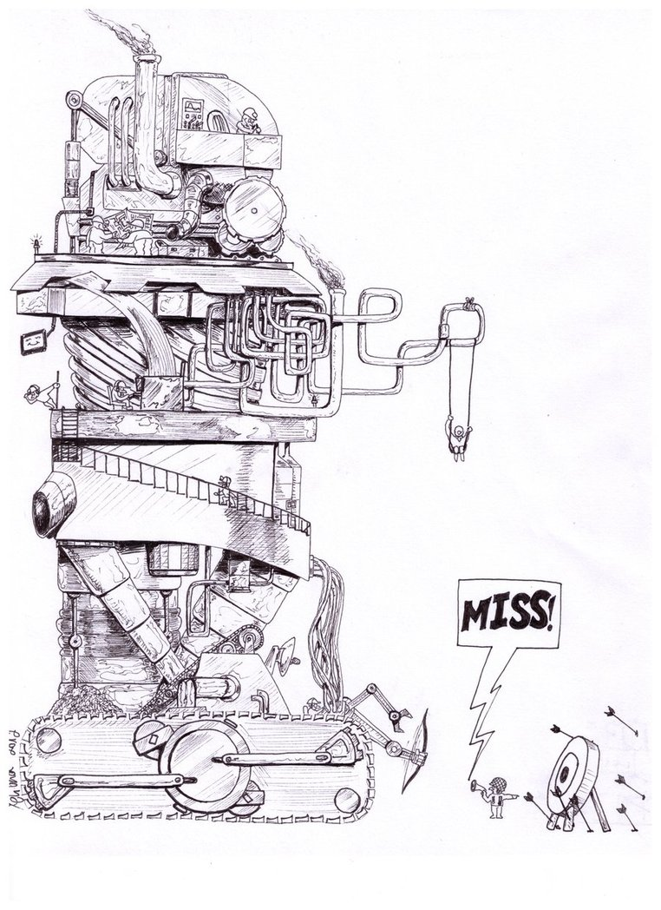
AGENTS
http://www.keywordsuggests.com/DT5zG9YMrnEK707aqUa2IhkNs5vUwu3mV6WrrLHR0soHddyR42EFvbEkYg9kaqswD%7CyremGnEFLO%7CzJXdp0SMQ/

Slide 83
withPool {
def blueShapesGuard = new Agent<List<Shape>>()
blueShapesGuard { updateValue [] }
shapes.findAllParallel({ shape -> shape.type == CIRCLE })
.findAllParallel({ shape -> shape.color == BLUE })
.eachParallel({ shape -> blueShapesGuard { it.add(shape) } })
}
send a message to set protected object’s value to empty list
send a message to invoke method add on protected object

Slide 84
Thread #1
Thread #2
Agent
blueCircles.add(shape)
blueCircles.add(shape)
blueCircles.add(shape)
blueCircles.add(shape)
blueCircles.add(shape)
blueCircles.add(shape)

Slide 85
withPool {
def blueShapesGuard = new Agent<Shape>()
blueShapesGuard { updateValue [] }
shapes.findAllParallel({ shape -> shape.type == CIRCLE })
.findAllParallel({ shape -> shape.color == BLUE })
.eachParallel({ shape -> blueShapesGuard { it.add(shape) } })
}
blueShapesGuard.addListener { oldValue, newValue -> … }
blueShapesGuard.addValidator { oldValue, newValue -> … }
println blueShapesGuard.val
blueShapesGuard.valAsync { println it }

Slide 87
final Agent<List<Shape>> blueShapesGuard = new Agent<>();
blueShapesGuard.send(new ArrayList<>());
blueShapesGuard.send(new MessagingRunnable<List<Shape>>() {
@Override
protected void doRun(List<Shape> value) {
value.add(shape);
}
});
blueShapesGuard.valAsync(new MessagingRunnable<List<Shape>>() {
@Override
protected void doRun(List<Shape> value) {
System.out.println(value);
}
});

Slide 88

Thread #1
Thread #2
Agent
blueCircles.add(shape)
blueCircles.add(shape)
blueCircles.add(shape)
blueCircles.add(shape)
blueCircles.add(shape)
blueCircles.add(shape)

Slide 89

Thread #1
Thread #2
Actor
message
message
message
message
message
message

Slide 90
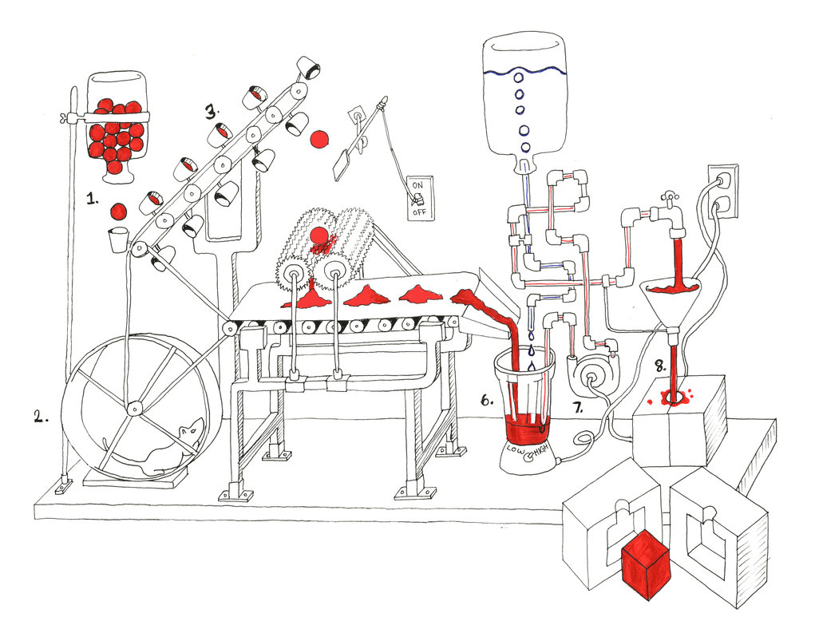
ACTORS
http://tommyboy5000.deviantart.com/art/Rube-Goldberg-machine-485199926

Slide 91
class ShapesGuardActor extends DefaultActor {
List<Shape> shapes
private void addShape(def shape) {
shapes.add shape
}
}

Slide 92
class ShapesGuardActor extends DefaultActor {
List<Shape> shapes
void afterStart() {
shapes = []
}
void act() {
loop {
react { def shape -> addShape shape }
}
}
private void addShape(def shape) {
shapes.add shape
}
}

Slide 93
class ShapesGuardActor extends DefaultActor {
List<Shape> shapes
void afterStart() {
shapes = []
}
void act() {
loop {
react { def shape -> addShape shape }
}
}
private void addShape(def shape) {
shapes.add shape
}
}
executed for received message
message

Slide 94
class ShapesGuardActor extends DefaultActor {
List<Shape> shapes
void afterStart() {
shapes = []
}
void act() {
loop {
react { def shape -> addShape shape }
}
}
private void addShape(def shape) {
shapes.add shape
}
}
continuously receive messages, one thread at most

Slide 95
class KeywordStoreActor extends DefaultActor {
KeywordsRepository keywordsRepository
void act() {
loop {
react { def keyword -> keywordsRepository.store keyword }
}
}
}

Slide 96
def keywordStoreActor = actor {
loop {
react { def keyword ->
keywordsRepository.store keyword
}
}
}

Slide 97
def group = new DefaultPGroup(new DefaultPool(5))
def keywordStoreActor = group.actor {
loop {
react { def keyword ->
keywordsRepository.store keyword
}
}
}

Slide 98
def keywordStoreActor = actor {
loop {
react { def keyword ->
keywordsRepository.store id, keyword
}
}
}

Slide 99
def keywordStoreActor = actor {
loop {
react { def keyword ->
idGenerator << keyword
react { Id id ->
keywordsRepository.store id, keyword
}
}
}
}
send message
process answer
def idGenerator = actor {
loop {
react { def keyword ->
Id id = ...
keyword.reply id
}
}
}
reply to sender

Slide 100
def keywordStoreActor = actor {
loop {
react { def keyword ->
idGenerator << keyword
react { Id id ->
keywordsRepository.store id, keyword
}
}
}
}
def idGenerator = reactor { def keyword ->
Id id = ...
keyword.reply id
}

Slide 102
Closure keywordStoreHandler = new ReactorMessagingRunnable<Keyword, Object>() {
@Override protected Object doRun(final Keyword keyword) {
idGenerator.sendAndContinue(keyword, new MessagingRunnable<Id>() {
@Override protected void doRun(final Id id) {
keywordsRepository.store(id, keyword);
}
});
return null;
}
};
Actor keywordStoreActor = new ReactiveActor(keywordStoreHandler);
Closure idGeneratorHandler = new ReactorMessagingRunnable<Keyword, Id>() {
@Override protected Id doRun(Keyword argument) {
Id id = ...
return id;
}
};
Actor idGenerator = new ReactiveActor(idGeneratorHandler);

Slide 103
def keywordStoreActor = actor {
loop {
react { def keyword ->
idGenerator << keyword
react { Id id ->
keywordsRepository.store id, keyword
}
}
}
}
def idGenerator = reactor { def keyword ->
Id id = ...
keyword.reply id
}

Slide 104
def keywordStoreActor = actor {
loop {
react { def keyword ->
idGenerator << keyword
react { Id id ->
keywordsRepository.store id, keyword
}
}
}
}
def idGenerator = reactor { def message ->
if (message instanceof Keyword) {
id = ...
}
if (message instanceof Tweet) {
id = ...
}
message.reply id
}

Slide 105
def keywordStoreActor = actor {
loop {
react { def keyword ->
idGenerator << keyword
react { Id id ->
keywordsRepository.store id, keyword
}
}
}
}
def idGenerator = reactor { def message ->
if (message instanceof Keyword) {
id = ...
}
if (message instanceof Tweet) {
id = ...
}
if (message instanceof FacebookPost) {
id = ...
}

Slide 106
def keywordStoreActor = actor {
loop {
react { def keyword ->
idGenerator << keyword
react { Id id ->
keywordsRepository.store id, keyword
}
}
}
}
def idGenerator = messageHandler {
when { Keyword keyword -> reply generateKeywordId(keyword) }
when { Tweet tweet -> reply generateTweetId(tweet) }
when { FacebookPost facebookPost -> reply generateFacebookPostId(facebookPost) }
}

Slide 108
Closure keywordStoreHandler = new ReactorMessagingRunnable<Keyword, Object>() {
@Override protected Object doRun(final Keyword keyword) {
idGenerator.sendAndContinue(keyword, new MessagingRunnable<Id>() {
@Override protected void doRun(final Id id) {
keywordsRepository.store(id, keyword);
}
});
return null;
}
};
Actor keywordStoreActor = new ReactiveActor(keywordStoreHandler);
Actor idGenerator = new DynamicDispatchActor() {
public void onMessage(final Keyword keyword) {
replyIfExists(generateKeywordId(keyword));
}
public void onMessage(final Tweet tweet) {
replyIfExists(generateTweetId(tweet));
}

Slide 109
def keywordStoreActor = actor {
loop {
react { def keyword ->
idGenerator << keyword
react { Id id ->
keywordsRepository.store id, keyword
}
}
}
}
def idGenerator = reactor { def keyword ->
Id id = generateId(keyword)
keyword.reply id
}

Slide 110
def keywordStoreActor = actor {
loop {
react { def keyword ->
idGenerator << keyword
react { Id id ->
keywordsRepository.store id, keyword
}
}
}
}
def idGenerator = reactor { def keyword ->
Id id = generateId(keyword)
keyword.reply id
}

Slide 111
def keywordStoreActor = actor {
loop {
react { def keyword ->
idGenerator << keyword
react { Id id ->
keywordsRepository.store id, keyword
}
}
}
}
def idGenerator = reactor { def keyword ->
Id id = generateId(keyword)
keyword.reply id
}

Slide 112
keywordStoreActor
keyword
idGenerator
id

Slide 113
keyword
idGeneratorTask
keywordStoreTask
id

Slide 114
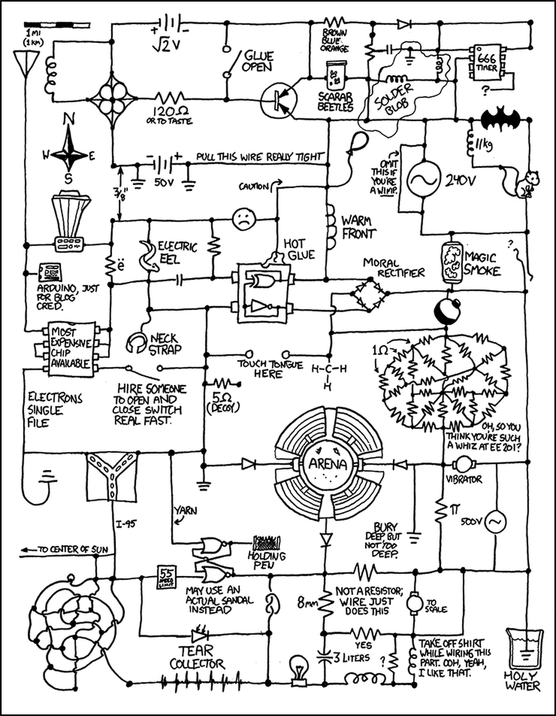
DATAFLOWS
http://www.projectroomseattle.org/programs-content/2014/6/preparing-for-the-failure-variety-show-the-rube-goldberg-confessionals

Slide 115
final def keyword = new DataflowVariable()
final def id = new DataflowVariable()
created
created

Slide 116
final def keyword = new DataflowVariable()
final def id = new DataflowVariable()
created
created
task {
keywordsRepository.store id, keyword
}
started asynchronously
blocked because id and keyword are not bound

Slide 117
final def keyword = new DataflowVariable()
final def id = new DataflowVariable()
created
created
task {
keywordsRepository.store id, keyword
}
blocked because id and keyword are not bound
task {
id = generateId(keyword)
}
blocked because keyword is not bound

Slide 118
final def keyword = new DataflowVariable()
final def id = new DataflowVariable()
created
created
task {
keywordsRepository.store id, keyword
}
blocked because id and keyword are not bound
task {
id = generateId(keyword)
}
blocked because keyword is not bound
task {
List keywords = keywordsService.extractKeywords()
keyword = orderByPriority(keywords)[0]
}
bind keyword

Slide 119
final def keyword = new DataflowVariable()
final def id = new DataflowVariable()
bound
created
task {
keywordsRepository.store id, keyword
}
blocked because id is not bound
task {
id = generateId(keyword)
}
bind id
task {
List keywords = keywordsService.extractKeywords()
keyword = orderByPriority(keywords)[0]
}

Slide 120
final def keyword = new DataflowVariable()
final def id = new DataflowVariable()
bound
bound
task {
keywordsRepository.store id, keyword
}
done
task {
id = generateId(keyword)
}
task {
List keywords = keywordsService.extractKeywords()
keyword = orderByPriority(keywords)[0]
}

Slide 121
final def keyword = new DataflowVariable()
final def id = new DataflowVariable()
task {
id = generateId(keyword)
}
task {
keywordsRepository.store id, keyword
}
task {
List keywords = keywordsService.extractKeywords()
keyword = orderByPriority(keywords)[0]
}

Slide 122
final def keyword = new DataflowVariable()
final def id = new DataflowVariable()
task {
keyword = orderByPriority(keywordsService.extractKeywords())[0]
}
task {
id = generateId(keyword)
}
task {
keywordsRepository.store id, keyword
}

Slide 123
final def keyword = new DataflowVariable()
final def id = new DataflowVariable()
task {
keyword = orderByPriority(keywordsService.extractKeywords())[0]
}
task {
keywordsRepository.store id, keyword
}
task {
id = generateId(keyword)
}

Slide 125
final DataflowVariable<Keyword> keyword = new DataflowVariable<>();
final DataflowVariable<Id> id = new DataflowVariable<>();
task(lambdaToClosure(() -> {
keywordsRepository.store(id.getVal(), keyword.getVal());
}));
task(lambdaToClosure(() -> {
id.bind(generateId(keyword.getVal()));
}));
task(lambdaToClosure(() -> {
List<Keyword> keywords = keywordsService.extractKeywords();
keyword.bind(orderByPriority(keywords).get(0));
}));

Slide 126
final def keyword = new DataflowVariable()
final def id = new DataflowVariable()
task {
keywordsRepository.store id, keyword
}
task {
id = generateId(keyword)
}
task {
List keywords = keywordsService.extractKeywords()
keyword = orderByPriority(keywords)[0]
}
started asynchronously
blocked because id and keyword are not bound

Slide 127
final def keyword = new DataflowVariable()
final def id = new DataflowVariable()
whenAllBound(keyword, id) {
keywordsRepository.store id, keyword
}
task {
id = generateId(keyword)
}
task {
List keywords = keywordsService.extractKeywords()
keyword = orderByPriority(keywords)[0]
}
blocked until all mentioned variables are bound

Slide 128
final def keywords = new DataflowVariable()
task {
def keyword = orderByPriority(keywords)[0]
keywordsRepository.store keyword
}
task {
keywords = keywordsService.extractKeywords()
}

Slide 129
final def keywords = new DataflowVariable()
keywords.whenBound {
def keyword = orderByPriority(keywords)[0]
keywordsRepository.store keyword
}
task {
keywords = keywordsService.extractKeywords()
}

Slide 130
task {
keywordsService.extractKeywords()
}.whenBound {
def keyword = orderByPriority(keywords)[0]
keywordsRepository.store keyword
}

Slide 131
task {
keywordsService.extractKeywords()
}.whenBound {
Promise orderedKeywords = orderByPriorityAsync(keywords)
orderedKeywords.whenBound {
keywordsRepository.store orderedKeywords[0]
}
}

Slide 132
task {
keywordsService.extractKeywords()
}.then orderByPriority
then { it[0] }
then keywordsRepository.&store

Slide 133
task {
keywordsService.extractKeywords()
}.then priorityOrderActor.&sendAndPromise then { it[0] } then repositoryStoreActor.&sendAndPromise

Slide 134
final def keywords = new DataflowQueue()
task {
while (true) { keywordsRepository.store keywords.val }
}
blocked until new value is bound
task {
keywordsService.extractKeywords().each { keyword ->
keywords << keyword
}
}
bind new value

Slide 135
final def keywords = new DataflowQueue()
task {
while (true) { keywordsRepository.store keywords.val }
}
task {
withPool {
List allKeywords = keywordsService.extractKeywords()
allKeywords.findAllParallel({!spamService.isSpam(it)}).each { keyword ->
keywords << keyword
}
}
}

Slide 136
final def keywords = new DataflowQueue()
task {
while (true) { keywordsRepository.store keywords.val }
}
task {
keywordsService.extractKeywords().each { keyword ->
keywords << keyword
}
}
task {
while (true) { logService.debug keywords.val }
}

Slide 137
final def keywordsBroadcast = new DataflowBroadcast()
final def keywordsRepositoryChannel = keywordsBroadcast.createReadChannel()
final def keywordsLogChannel = keywordsBroadcast.createReadChannel()
task {
while (true) { keywordsRepository.store keywordsRepositoryChannel.val }
}
task {
keywordsService.extractKeywords().each { keyword ->
keywordsBroadcast << keyword
}
}
task {
while (true) { logService.debug keywordsLogChannel.val }
}

Slide 138
final def keywords = new DataflowQueue()
splitter (keywords, [ keywordsForStoring, keywordsForLogging ])
operator (inputs: [ keywordsForStoring ], outputs: []) { keywordForStoring ->
keywordsRepository.store keywordForStoring
}
task {
keywordsService.extractKeywords().each { keyword ->
keywords << keyword
}
}
keywordsForLogging.wheneverBound {
logService.debug it
}

Slide 139
final def keywords = new DataflowQueue()
splitter (keywords, [ keywordsForId, keywordsForLogging ])
operator (inputs: [ id, keywordsWithId ], outputs: []) { id, keywordsWithId ->
keywordsRepository.store id, keywordsWithId
}
task {
keywordsService.extractKeywords().each { keyword ->
keywords << keyword
}
}
operator (inputs: [ keywordsForId ], outputs: [ id, keywordsWithId ]) { keyword ->
bindAllOutputValues generateId(keyword), keyword
}
keywordsForLogging.wheneverBound {
logService.debug it
}

Slide 140
splitter (keywords, [ keywordsForId, keywordsForLogging ])
operator (inputs: [ id, keywordsWithId ], outputs: []) { id, keywordsWithId ->
keywordsRepository.store id, keywordsWithId
}
selector (inputs: [ fromWatsons, fromGoogle ], outputs: [ keywords ]) { fromOneOf ->
fromOneOf.each {
bindOutput 0, it
}
}
operator (inputs: [ keywordsForId ], outputs: [ id, keywordsWithId ]) { keyword ->
bindAllOutputValues generateId(keyword), keyword
}
keywordsForLogging.wheneverBound {
logService.debug it
}

Slide 141
DataflowBroadcast
DataflowVariable
DataflowQueue
can be bound once
attempt to read unbound value suspend execution until value is bound
bound value can be read multiple times
can be bound multiple times
attempt to read unbound value suspend execution until new value is bound
each bound value can be read once
can be bound multiple times
attempt to read unbound value suspend execution until new value us bound
each bound value can be read once for each reader

Slide 142
splitter
task
whenBound
started when variable is bound
immediately produce several outputs exactly the same as input
started immediately, suspended when reach unbound value

Slide 143
operator
selector
started when all inputs are bound, bind outputs
started when at least one input is bound, bind outputs

Slide 144
fromWatsons
fromGoogle
selector
keywords
splitter
keywordsForLogging
keywordsForId
whenBound
logService.debug it
id
generateId(keyword)
keywordsRepository.store id, keywordsWithId
keywordsWithId

Slide 145
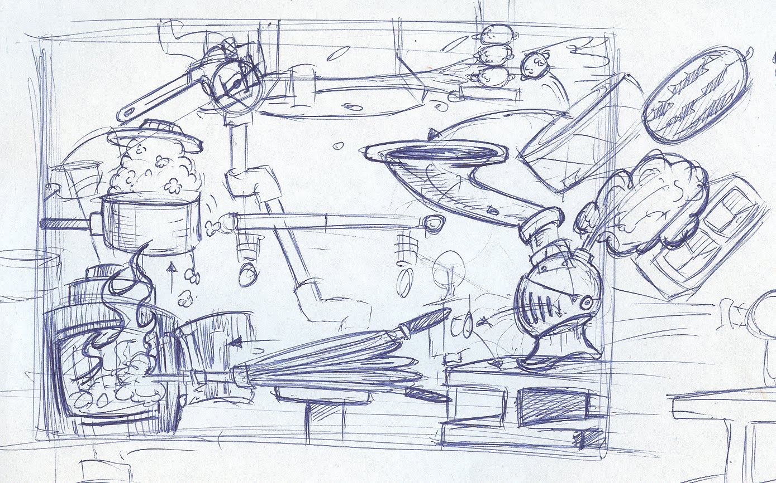
LESSONS LEARNED

Slide 146
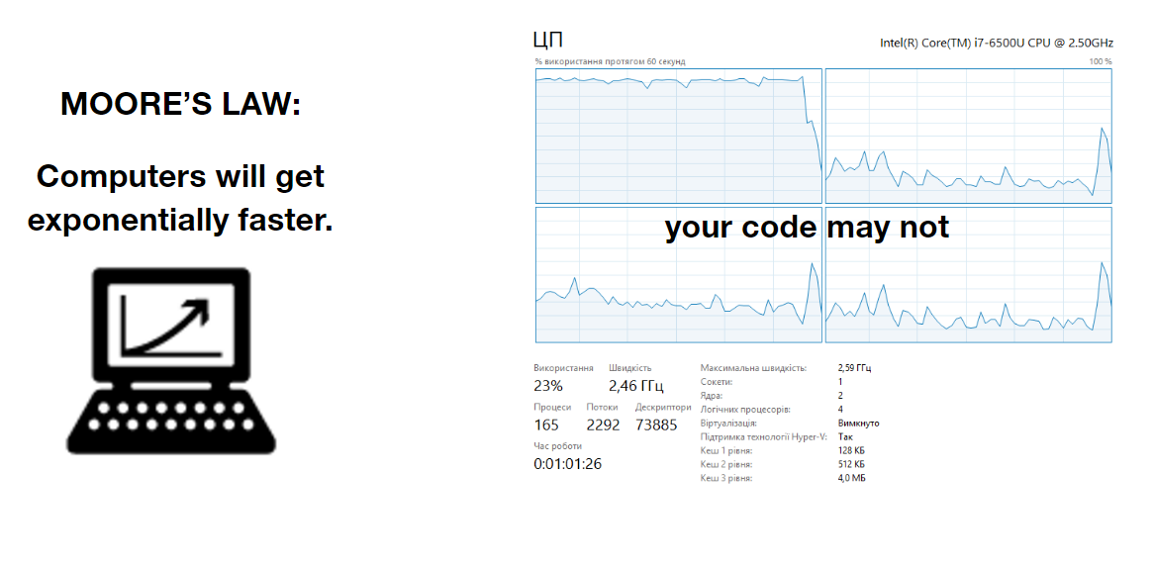
LESSONS LEARNED

Slide 147
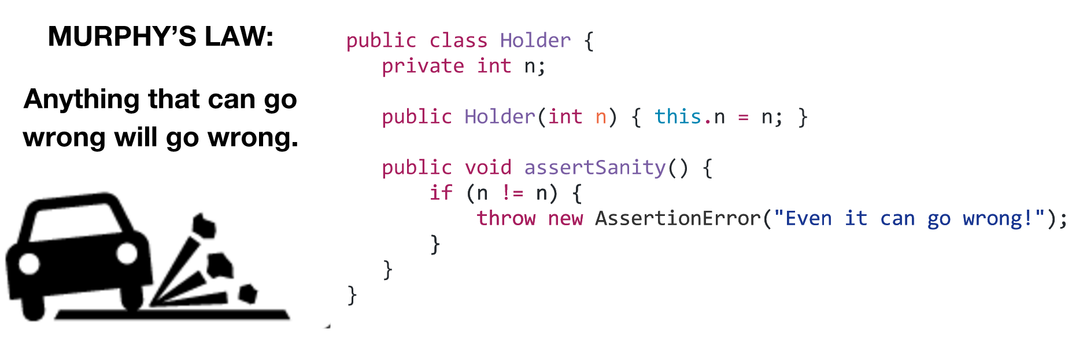
LESSONS LEARNED

Slide 148
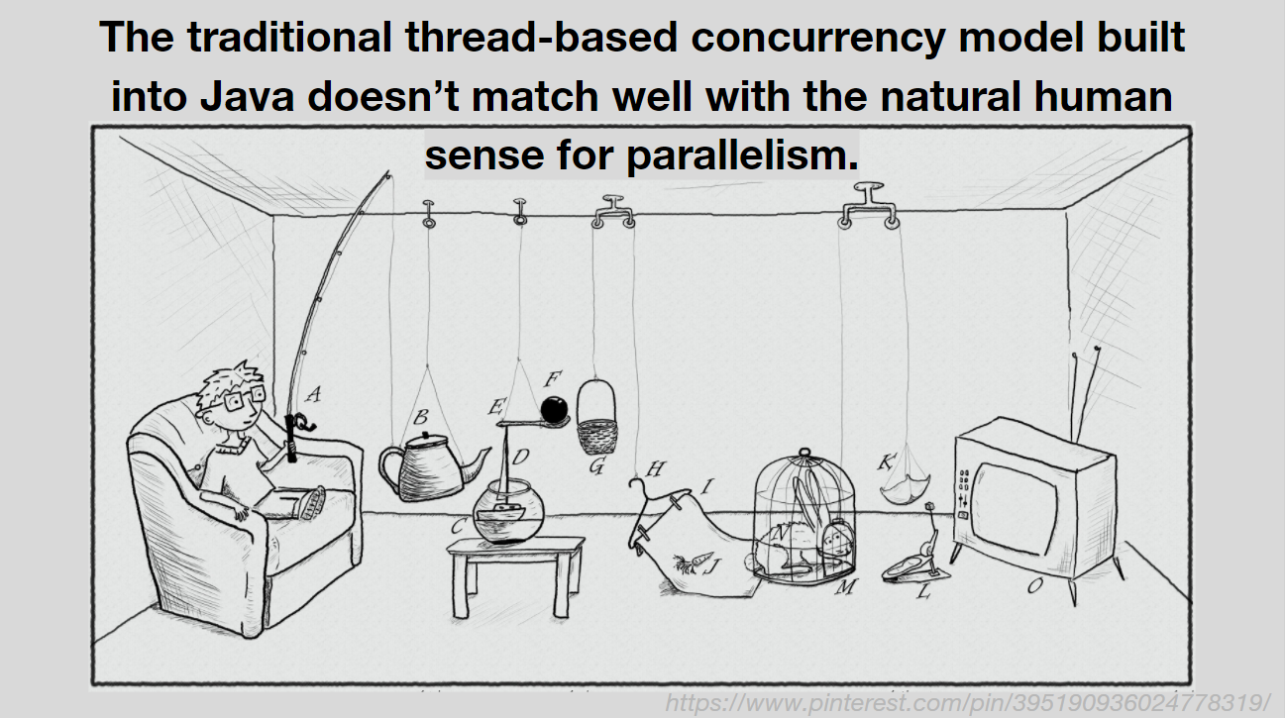
LESSONS LEARNED

Slide 149
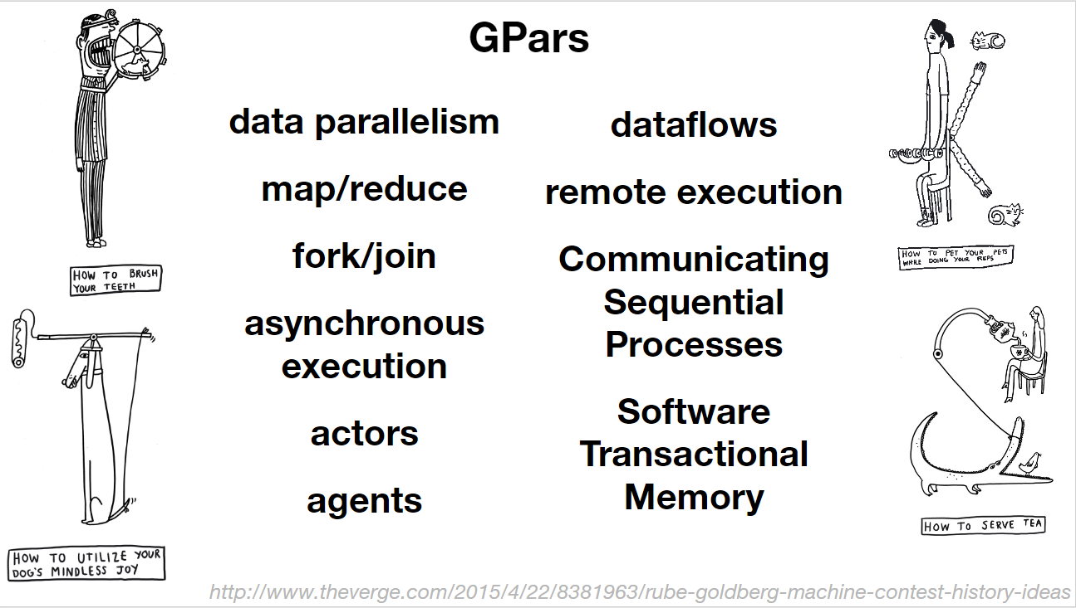
LESSONS LEARNED

Slide 150
LESSONS LEARNED
Java 8 Streams API is better

Slide 151
LESSONS LEARNED
for all long-running tasks

Slide 152
LESSONS LEARNED
protect inevitably mutable objects

Slide 153
LESSONS LEARNED
define tasks and explicitly coordinate them

Slide 154
LESSONS LEARNED
define flows of data and how it should be processed

Slide 155
LESSONS LEARNED
learn more if you are interested

Slide 156
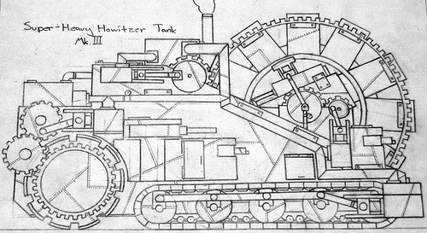
LEARN MORE IF YOU ARE INTERESTED
Official site The GPars User Guide
Groovy and Concurrency with GPars by Paul King
Gpars: Concurrency in Java & Groovy by Ken Kousen
'Concurrent Groovy with GPars' chapter from 'Groovy in Action' book
Sources Samples
Slack channel
https://s-media-cache-ak0.pinimg.com/originals/94/7b/55/947b558df61fd46caa6d041c1a21bb40.jpg

Slide 157
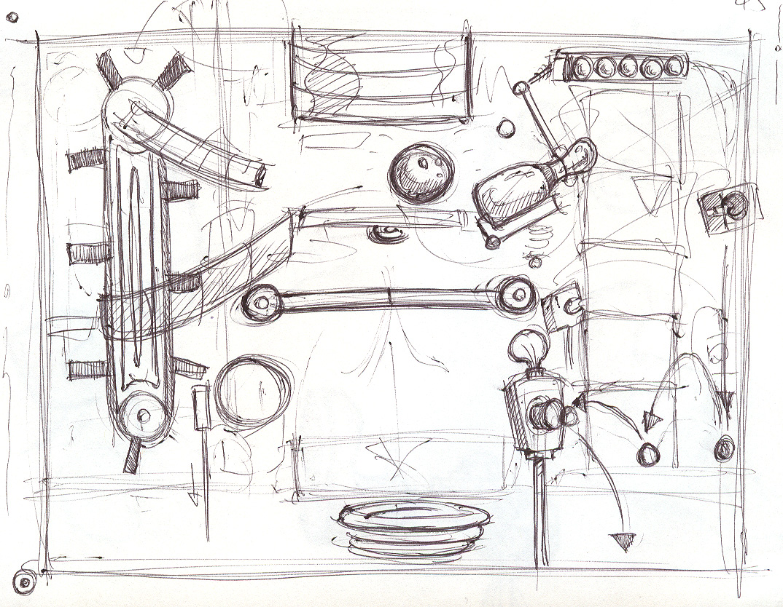
Q/A
THANK YOU!
http://sweetlygrotesque.blogspot.com/2012/01/concept-sketches-goldberg-machine.html

